Slide 1
Heredity and Evolution
EOC Review

Slide 2
Heredity and Evolution Frameworks
Students shall demonstrate an understanding of heredity.
Students shall investigate the molecular basis of genetics.
Students shall examine the development of the theory of biological evolution.

Slide 3
Heredity and Evolution
1. Summarize the outcomes of Gregor Mendel’s experimental procedures

Slide 4
Heredity and Evolution
2. Differentiate among the laws and principles of inheritance:
dominance
segregation
independent assortment

Slide 5
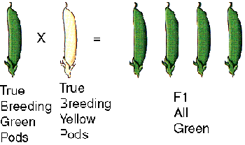
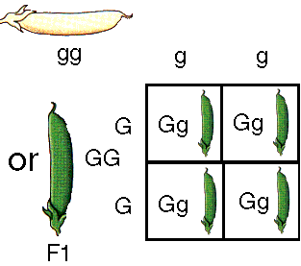
Mendel’s first cross
He crossed 2 true-breeding, or 2 pure bred pea plants. This is the P generation. All the offspring were heterozygous and all exhibited the dominant phenotype. Which is the dominant allele?

Slide 6
Conclusions from his first cross
The inheritance of biological characteristics is determined by individual units known as genes. Genes are passed from parents to offspring.
Law of dominance: In cases in which 2 or more forms (alleles) of the gene for a single trait exist, some forms of the gene may be dominant and others may be recessive.

Slide 7
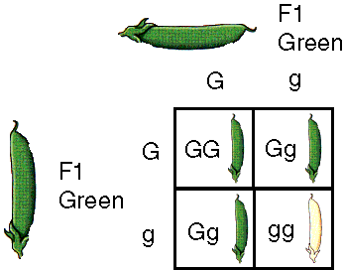
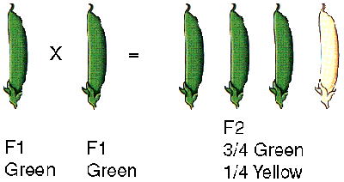
Mendel’s 2nd Cross
He crossed 2 of the F1 (heterozygous or hybrids), and the recessive allele reappeared in a 3 to 1 ratio.

Slide 8
Mendel’s conclusions from his 2nd cross
Law of segregation: In most sexually reproducing organisms, each adult has 2 copies of each gene- one from each parent. These genes are segregated from each other when gametes are formed.
The allele pairs are randomly united at fertilization

Slide 9
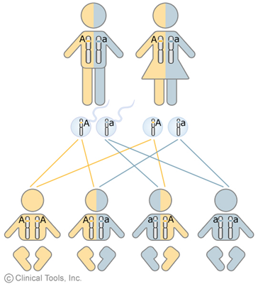
Law of Segregation

Slide 10
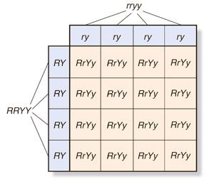
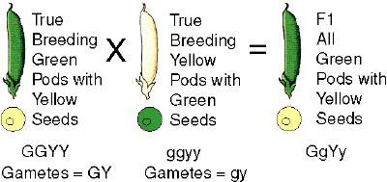
Mendel’s 3rd cross
When looking at plants with 2 traits, would both traits be transmitted to the offspring together or would one trait be transmitted independently of the other?

Slide 11
Test question:
How many different allele combinations would be found in the gametes produced by a pea plant whose genotype was RrYY? RRYY? RrYy?

Slide 12
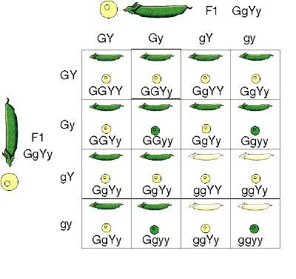
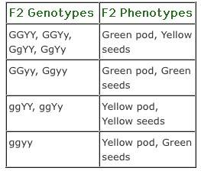
Dihybrid cross
9:3:3:1 ratio

Slide 13
Mendel’s conclusions from his 3rd cross
Law of independent assortment: This law states that allele pairs separate independently during the formation of gametes. Therefore, traits are transmitted to offspring independently of one another.
In other words, just because a the parent is Round and Yellow, doesn’t mean offspring have to be round and yellow-alleles segregate independently and you can have offspring that are round and green

Slide 14
Heredity and Evolution
3. Use the laws of probability and Punnett squares to predict genotypic and phenotypic ratios

Slide 15
Punnett Squares
The principles of probability can be used to predict the outcomes of genetic crosses
It does not determine the actual outcomes of the genetic crosses

Slide 16
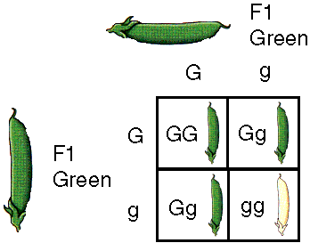
Quiz
What is the figure above called?
What do the alleles G and g represent in the figure above?
What is the phenotype of plant GG?
What is the phenotype of plant gg?
What is the genotype of the white pea pod?
Which genotypes are heterozygous? Name them.
What are the chances that a pea pod will be white?
If there were 375 plants, how many of them would be green?
What is the dominant trait in the figure above?
T represents the allele for tall, whereas t represents the allele for short. Create a punnet square and cross a homozygous tall plant with a heterozygous tall plant. What percentage of the offspring will be short?

Slide 17
Heredity and Evolution
4. Examine different modes of inheritance:
sex linkage
codominance
crossing over
incomplete dominance
multiple alleles

Slide 18
More Vocabulary
Incomplete Dominance
The situation in which the phenotype of heterozygotes is in between the phenotypes of homozygous individuals for either allele
Codominance
The situation where the phenotypes of both alleles are exhibited in the heterozygote
Multiple Alleles
When there are three or more alleles for a single gene (as in ABO blood groups)
Polygenic Inheritance
An additive effect of two or more genes on a single phenotypic trait

Slide 19

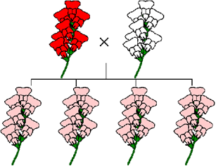
Codominance v incomplete dominance

Slide 20
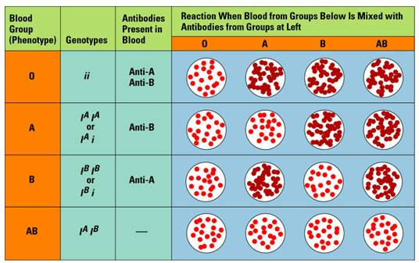
Multigenic or multiple alleles

Slide 21
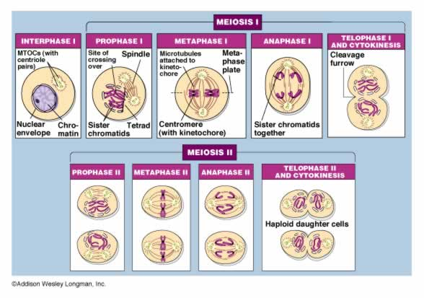

Slide 22
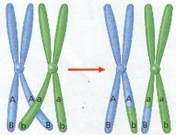
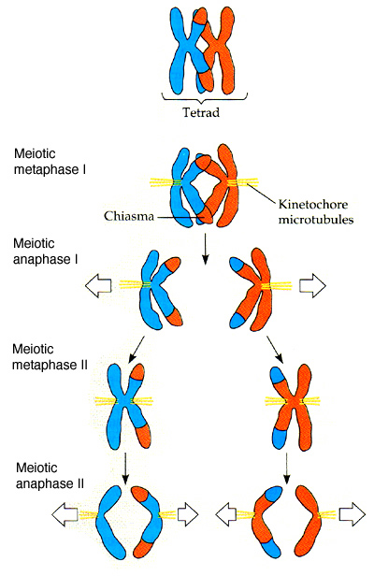
Crossing-over results in the exchange of alleles (forms of the gene-gene is on chromosome) between homologous chromosomes and produces new combinations of alleles: results in even more variation! What phase of meiosis does this occur? When do they form tetrads?

Slide 23
Sex-linked genes
Every person has an X chromosome because it contains genes that are vital in baby development
Why is colorblindness more common in males than in females?
What are the sex chromosomes for a girl/boy?
If it has a Y, the gender is considered male
XXY, XXXY, XXXXXY
Sex-linked disorders CAN be carried on the X or Y chromosome-we just examined disorders on the X chromosome

Slide 24
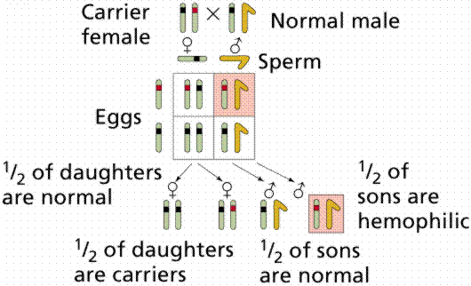

Slide 25
Heredity and Evolution
5. Analyze the historically significant work of prominent geneticists

Slide 26
http://www.ornl.gov/sci/techresources/Human_Genome/resource/people.shtml
Watson and Crick
Rosalind Franklin
Gregor Mendel
Barbara McClintock
Linus Pauling

Slide 27
Heredity and Evolution
6. Evaluate karyotypes for abnormalities:
monosomy
trisomy

Slide 28
Monosomy
The cell has only one copy of a specific chromosome. For example, individuals with Turner's syndrome have a single X chromosome and no Y.
Trisomy
The cell has an extra copy of a specific chromosome. Examples:
Down's syndrome - with three copies of chromosome 21.
Klinefelter's syndrome - with three sex chromosomes (XXY).

Slide 29
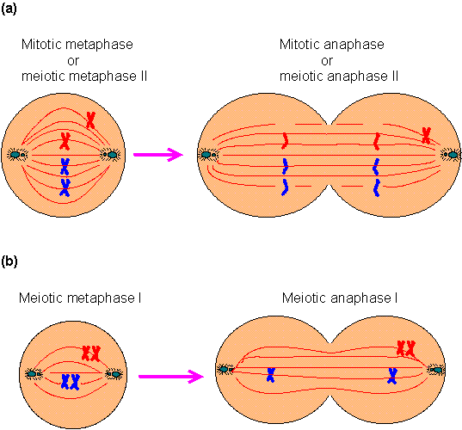
(a) During mitotic metaphase or meiotic metaphase II, one pair of sister chromatids does not align at the equatorial plane. Consequently, both sister chromatids move to the same cell. One daughter cell will show trisomy and another daughter cell will have monosomy. (b) During meiotic metaphase I, two homologous pairs of sister chromatids do not align at the equatorial plane and subsequently move to the same cell (a phenomenon called nondisjunction). The resulting daughter cells also have either monosomy or trisomy.

Slide 30
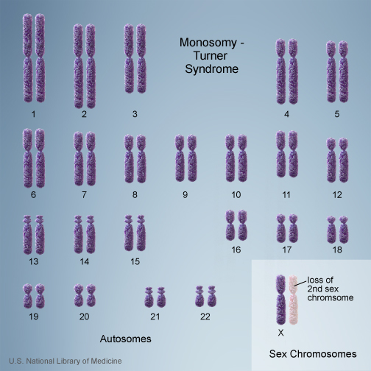
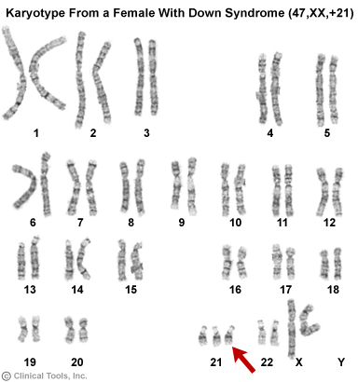
Monosomy v Trisomy

Slide 31
Heredity and Evolution
7. Model the components of a DNA nucleotide and an RNA nucleotide

Slide 32
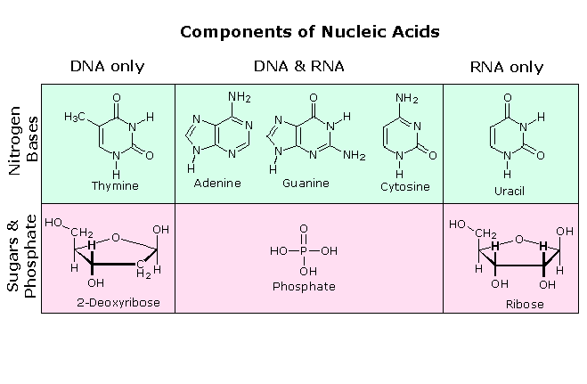
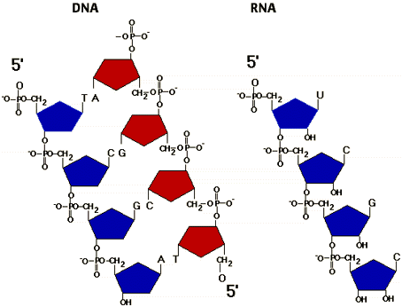

Slide 33
Heredity and Evolution
8. Describe the Watson-Crick double helix model of DNA, using the base-pairing rule (adenine-thymine, cytosine-guanine)

Slide 34
Watson and Crick suggested that the DNA molecule was made of two chains of nucleotides, each in a helix as Franklin had found, but one going up and the other going down. Crick had just learned of Chargaff's findings about base pairs in the summer of 1952. He added that to the model, so that matching base pairs (Adenine matches with Thymine, and Cytosine matches with Guanine) interlocked in the middle of the double helix to keep the distance between the chains constant.
Watson and Crick showed that each strand of the DNA molecule was a template for the other. During cell division the two strands separate and on each strand a new "other half" is built, just like the one before. This way DNA can reproduce itself without changing its structure -- except for occasional errors, or mutations.
The structure so perfectly fit the experimental data that it was almost immediately accepted.

Slide 35
Heredity and Evolution
9. Compare and contrast the structure and function of DNA and RNA

Slide 36
Complete the table comparing and contrasting the structure of DNA and RNA. Use the choices provided:
made up of of nucleotides, contains deoxyribose, contains ribose, contains a phosphate group, contains adenine, contains thymine, contains uracil, contains guanine, contains cytosine, double-stranded, single-stranded, contains a 5-carbon sugar, nucleic acids, polymer,
carbon compound, macromolecule
DNA | BOTH | RNA

Slide 37
Complete the table comparing and contrasting the function of DNA and RNA. Use the choices provided: involved in making proteins, has 3 types, serve as messengers from DNA to the rest of the cell, make up ribosomes along with many proteins, transfers amino acids to the ribosome, has the original gene “master plan” template, stays in the nucleus, goes to cytoplasm, goes to ribosomes
DNA | BOTH | RNA

Slide 38
Heredity and Evolution
10. Describe and model the processes of replication, transcription, and translation

Slide 39
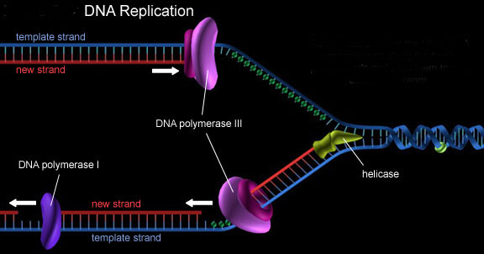
DNA Replication

Slide 40
DNA Replication
The enzyme helicase divides the DNA into 2 strands
DNA polymerase (a special enzyme) pairs nucleotides with it’s corresponding pair on the unwound DNA strand
The result is two exact copies of the original DNA strand
Mistakes during replication lead to mutations

Slide 41
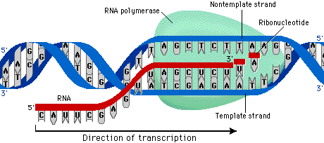
Transcription

Slide 42
Transcription
Occurs in the nucleus, since DNA stays in the nucleus
Produces a single strand of mRNA
RNA polymerase attaches to the unwound DNA strand. The place it attaches is called the promoter. RNA polymerase starts encoding mRNA when it reads the TAC on DNA, which produces the “start” codon on mRNA which is AUG. The mRNA will continue to be produced until a stop codon is reached.

Slide 43
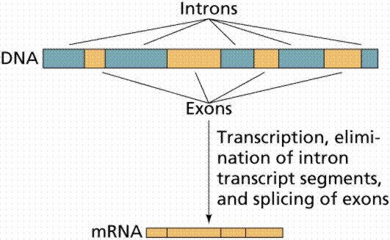
mRNA editing
After transcription, the mRNA is edited. Sections of the mRNA that don’t produce amino acids are rid of. They are called introns. The sections that stay and are eventually expressed as amino acids are spliced together and they are called exons.

Slide 44
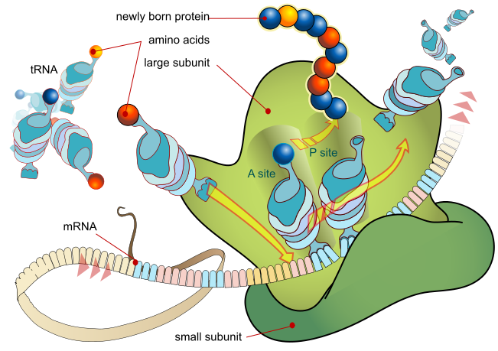
Translation

Slide 45
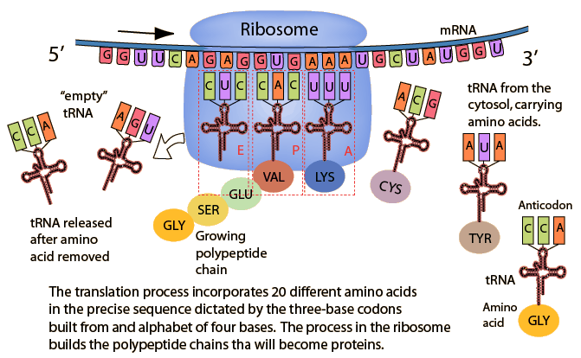
Translation

Slide 46
Translation
The mRNA travels outside the nucleus, to the cytoplasm, and attaches to a ribosome. Ribosomes contain rRNA.
During translation, a protein is produced.
The mRNA scrolls through the ribosome like a conveyor belt. The anticodons on tRNA attaches to the corresponding codons on the mRNA. The tRNA carries an amino acid. One the amino acid is attached, the empty tRNA leaves, and a chain of amino acids is built. Once the stop codon is read, translation stops. The amino acid chain folds into a protein.
Bonds between amino acids are called peptide bonds. This is why proteins are also referred to as polypeptides.

Slide 47
Heredity and Evolution
11. Compare and contrast the different types of mutation events, including point mutation, frameshift mutation, deletion, and inversion

Slide 48
Gene Mutations
Point mutations: involves changes in one of a few nucleotides
Substitutions
Insertions
Deletions
Frameshift mutations: changes every amino acid that follows the point of the mutation
See page 307 figure 12-20

Slide 49
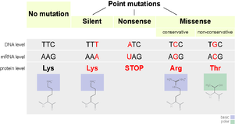

Slide 50
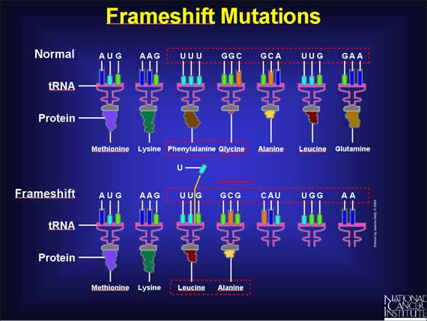

Slide 51
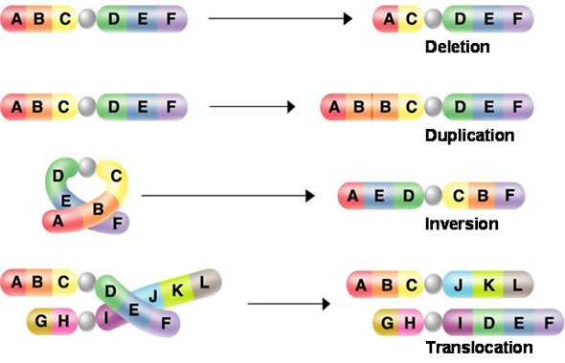
Chromosomal Mutations

Slide 52
Heredity and Evolution
12. Identify effects of changes brought about by mutations:
beneficial
harmful
neutral

Slide 53
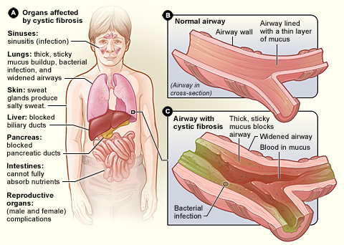
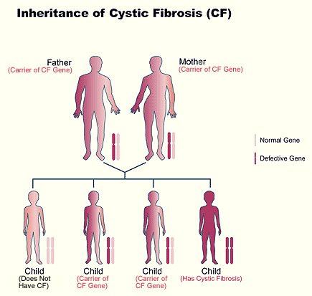
Cystic Fibrosis
Disorder caused by a recessive allele

Slide 54
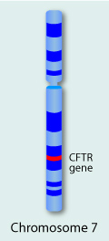
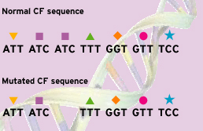
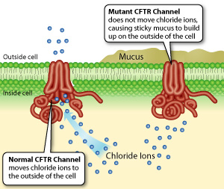
Three DNA bases are deleted in the mutated sequence, resulting in the deletion of an amino acid (phenylalanine) from the CF protein. People with the abnormal protein develop cystic fibrosis

Slide 55
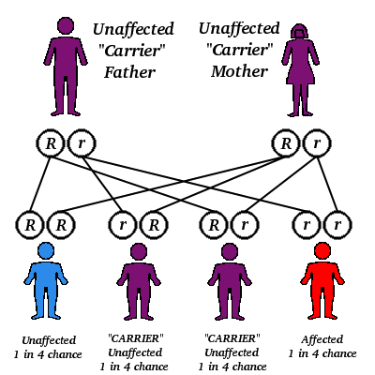
Sickle-Cell Disease
Codominant Allele because heterozygotes have a different phenotype: resistance to malaria. Since both alleles contribute to the phenotype it is considered codominant. Therefore, this could be a good or bad mutation depending on if you are heterozygous (good), or homozygous dominant (bad because you could get malaria) or homozygous recessive (bad because you have sickle-cell disease)

Slide 56
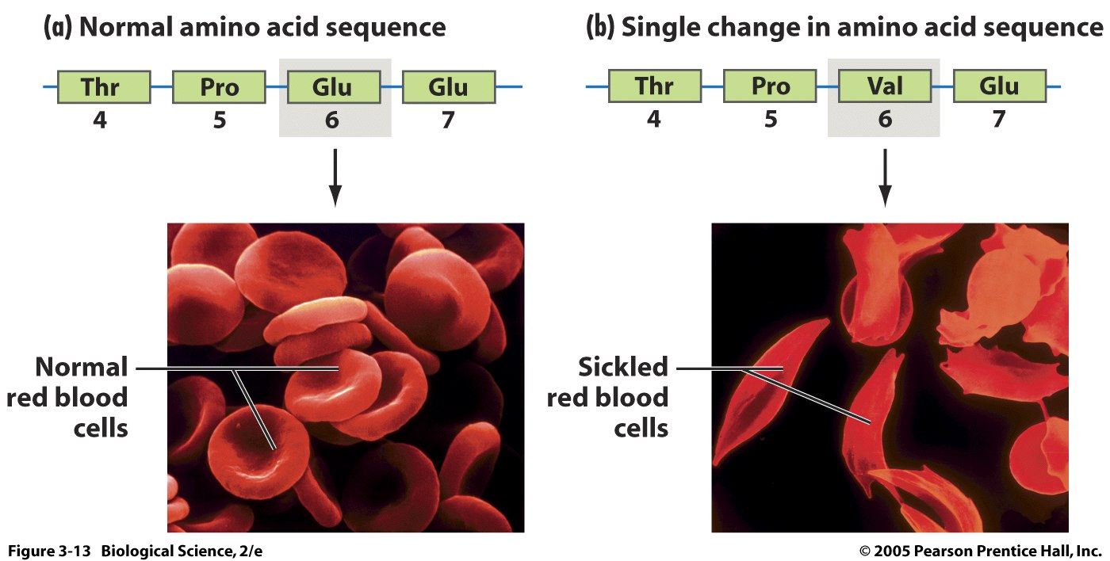

Slide 57
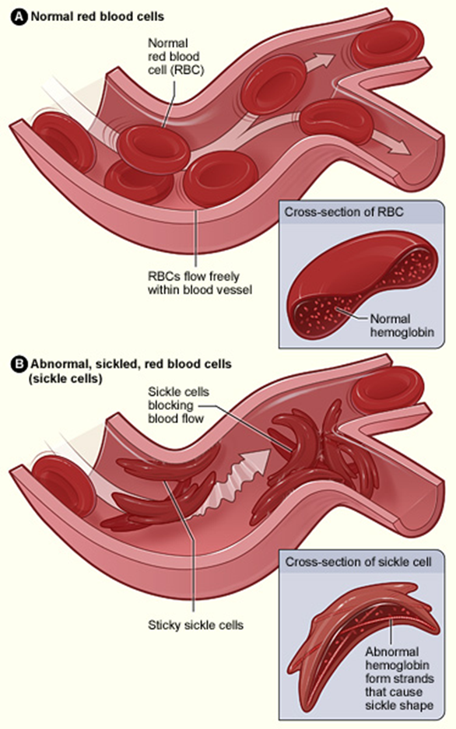

Slide 58
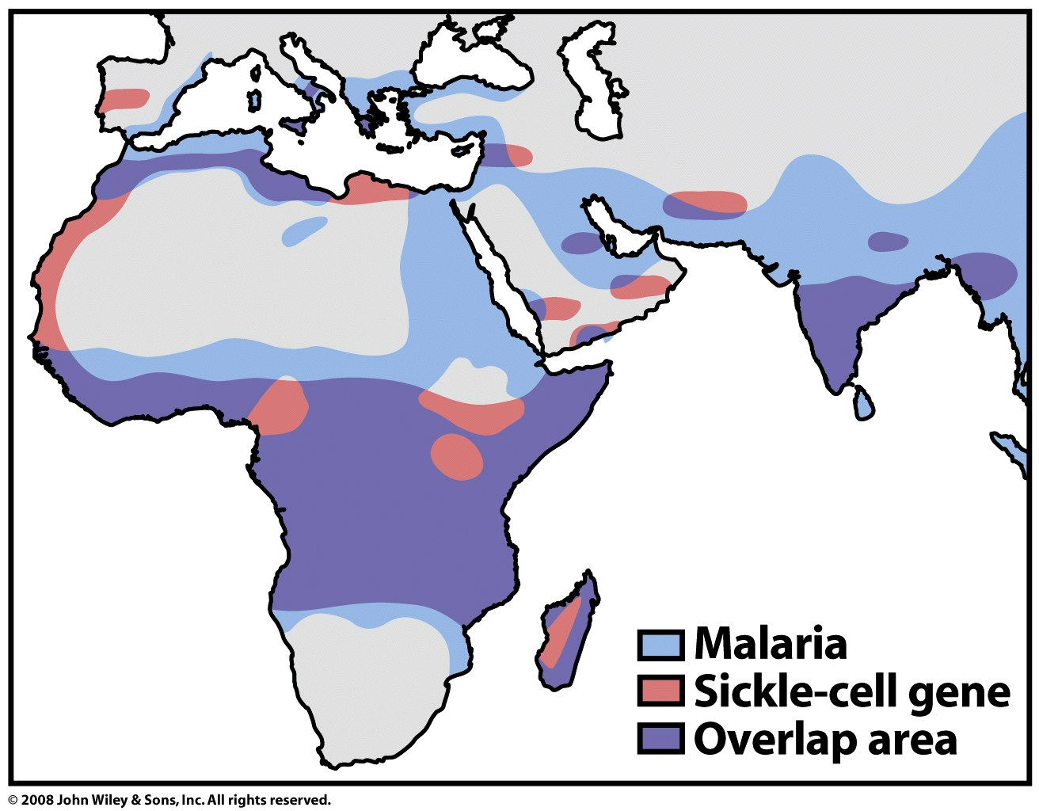
Other mutations: See page 345 Figure 14-6

Slide 59
So are mutations always harmful?
Harmful
Some depend on the environment
Peppered moth example
Some depend on if it is dominant, recessive, or co-dominant and if it is present in both parents or not
Sickle Cell Disease (rr)
Some changes the protein slightly and it isn’t functional or doesn’t serve a good purpose
Helpful
Some depend on the environment
Peppered moth example
Some depend on if it is dominant, recessive, or co-dominant and if it is present in both parents or not
Sickle Cell Disease (Rr)
Some changes the protein slightly and it serves a good new purpose
Neutral
Some result in no change in the amino acid (silent)
Some result in a change of a protein but it still functions normally

Slide 60
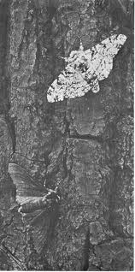
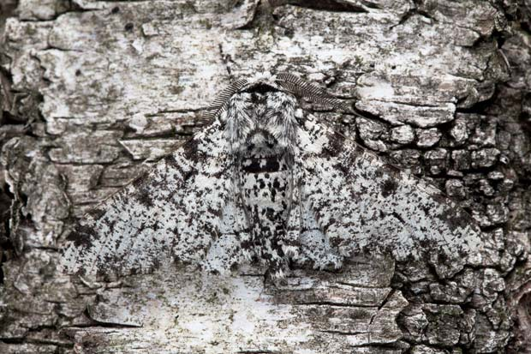
English peppered moth

Slide 61
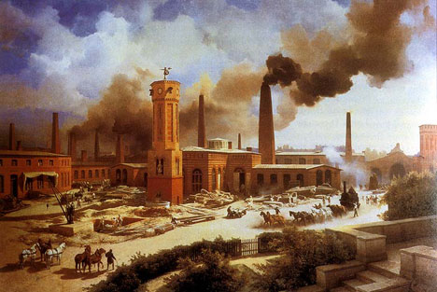
Industrial Revolution

Slide 62

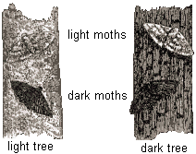

Slide 63
Whether a mutation is helpful or harmful sometimes depends on the environment
Before the Industrial Revolution, a mutation which changed light moths into dark moths was an unfavorable (harmful) mutation, whereas during the dark years it was a favorable (helpful) mutation.

Slide 64
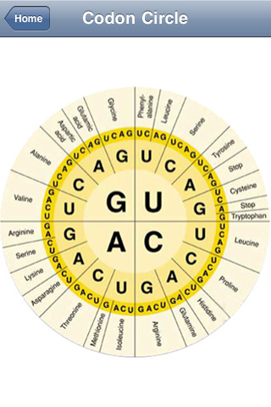

Neutral Mutations
Sometimes a substitution of a nucleotide will still lead to the same amino acid having no affect at all (called a silent mutation).

Slide 65
Neutral mutations
Sometimes the part of the mRNA or DNA that was mutated gets discarded as an intron during editing.

Slide 66
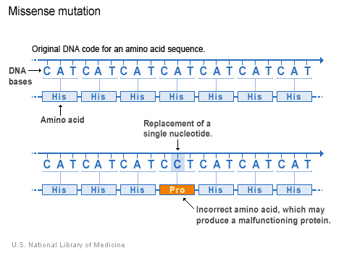
Neutral/good/bad mutations
We get a different amino acid producing a slightly different protein.
Neutral: Most of the time the new protein works very much the same as the old protein - it catalyzes the same reactions.
Good: Sometimes it's functional capability changes; it now catalyzes a different reaction. When this happens there may be another protein which also handled the original task; in this case we've added a capability.
Bad: If there wasn't a protein that can do what this mutated protein can do, it replaces the missing protein with a new one with different capabilities.

Slide 67
Fatal (bad) mutations
What happen to these mutations?
Do they get passed on?
The average human being has about 50-100 mutations, of which about 3 matter, i.e., they actually change a protein. If the typical mutation were deleterious life would go extinct very quickly.

Slide 68
Good mutations
For survival
Bacteria develop antibiotic resistance
Flu Shot
Insects develop pesticide resistance
DDT
Humans develop resistance to malaria
Sickle Cell Disease-Heterozygous
Humans develop resistance to atherosclerosis
Humans develop Immunity to HIV
Humans developing lactose tolerance
The onset of lactose intolerance makes it easy to wean the young. Human beings, however, have taken up the habit of eating milk products. This is not universal; it is something that originated in cultures that kept cattle and goats. In these cultures lactose tolerance had a strong selective value.

Slide 69
Heredity and Evolution
13. Compare and contrast Lamarck’s explanation of evolution with Darwin’s theory of evolution by natural selection

Slide 70
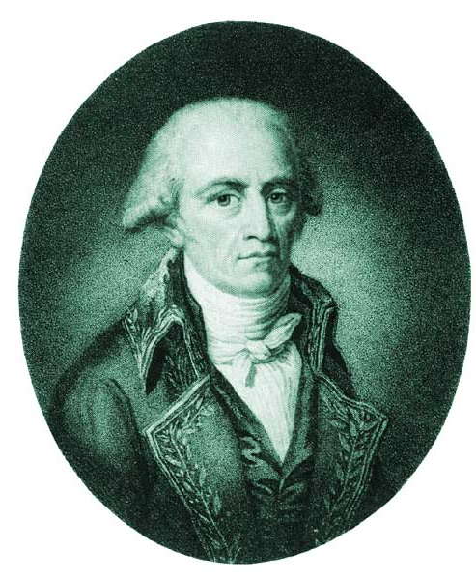
Lamarck’s Theory of Evolution
Jean-Baptiste Lamarck, 1809
One Of First Scientists To Understand That Change Occurs Over Time
Stated that Changes Are Adaptations To Environment acquired in an organism’s lifetime
Said acquired changes were passed to offspring

Slide 71
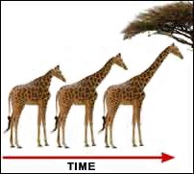
Lamarck’s Theory of Evolution
Idea called Law of Use and Disuse
If a body part were used, it got stronger
If body part NOT used, it deteriorated

Slide 72
Lamarck’s Theory of Evolution
Inheritance of Acquired Characteristics
Proposed That By Selective Use Or Disuse Of Organs, Organisms Acquired Or Lost Certain Traits During Their Lifetime
These Traits Could Then Be Passed On To Their Offspring
Over Time This Led To New Species

Slide 73
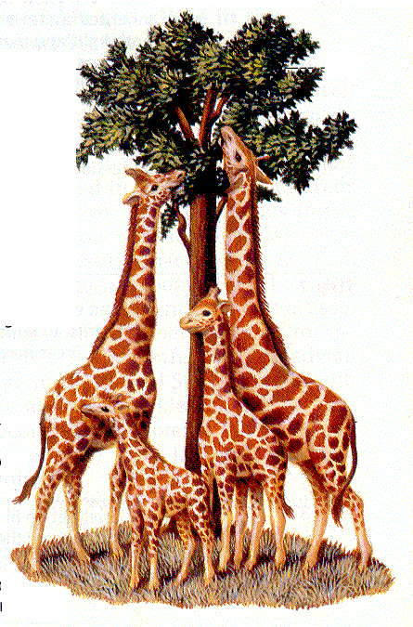
Lamarck’s Theory of Evolution
Use & Disuse - Organisms Could Change The Size Or Shape Of Organs By Using Them Or Not Using Them
Blacksmiths & Their Sons (muscular arms)
Giraffe’s Necks Longer from stretching)

Slide 74
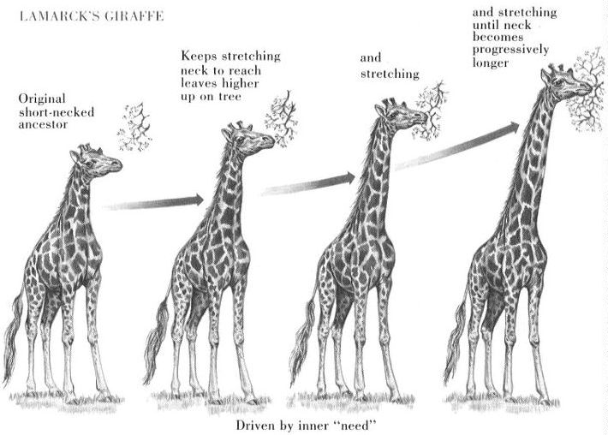

Slide 75
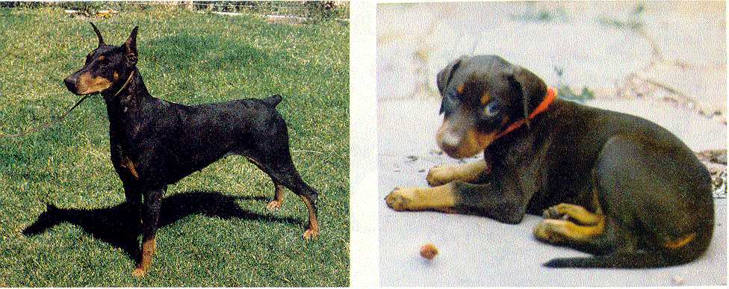
Lamarck’s Theory of Evolution
Inheritance Of Acquired Traits
Traits Acquired During Ones Lifetime Would Be Passed To Offspring
Clipped ears of dogs could be passed to offspring!

Slide 76
Lamarck’s Theory of Evolution
Tendency Toward Perfection
Organisms Are Continually Changing and Acquiring Features That Help Them Live More Successfully In Their Environment
Example: Bird Ancestors Desired To Fly So They Tried Until Wings Developed

Slide 77
Lamarck’s Mistakes
Lamarck Did NOT Know how traits were inherited (Traits are passed through genes)
Genes Are NOT Changed By Activities In Life
Change Through Mutation Occurs Before An Organism Is Born

Slide 78
Darwin’s Observations & Conclusions
The Struggle for Existence

Slide 79
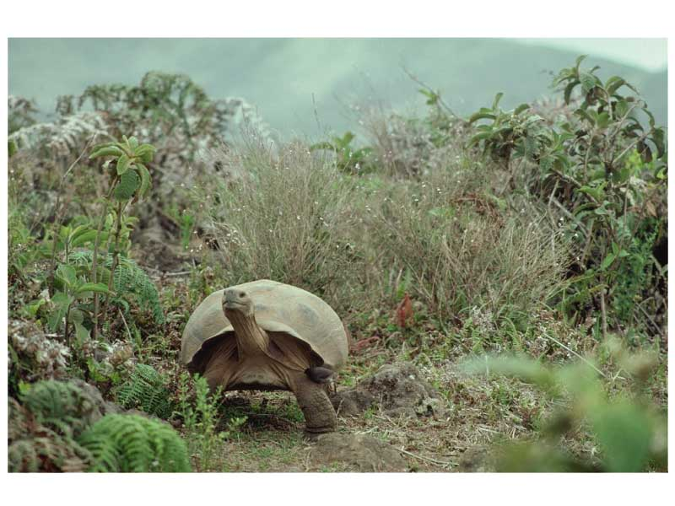

Definition
Evolution is the change in allele frequency in a population over successive generations

Slide 80

Darwin’s Observations
Left unchecked, the number of organisms of each species will increase exponentially, generation to generation
In nature, populations tend to remain stable in size
Environmental resources are limited

Slide 81

Darwin’s Conclusion
Production of more individuals than can be supported by the environment leads to a struggle for existence among individuals
Only a fraction of offspring survive each generation
Survival of the Fittest

Slide 82

Darwin’s Observations
Individuals of a population vary extensively in their characteristics with no two individuals being exactly alike.
Much of this variation between individuals is inheritable.

Slide 83

Darwin’s Conclusion
Individuals who inherit characteristics most fit for their environment are likely to leave more offspring than less fit individuals
Called Natural Selection

Slide 84

Darwin’s Theory of Evolution
The unequal ability of individuals to survive and reproduce leads to a gradual change in a population, with favorable characteristics accumulating over generations (natural selection)
New species evolve

Slide 85
Darwin’s Theory of Evolution
Organisms Change Over Time

Slide 86

Common Descent with Modification
Darwin proposed that organisms descended from common ancestors
Idea that organisms change with time, diverging from a common form
Caused evolution of new species

Slide 87

Natural Selection
Driving force for evolution
During the struggle for resources, strongest survive & reproduce
Idea that at least some of the differences between individuals, which impact their survival and fertility, are inheritable
.

Slide 88
Evolution By Natural Selection Concepts
The Struggle for Existence (compete for food, mates, space, water, etc.)
Survival of the Fittest (strongest able to survive and reproduce)
Descent with Modification (new species arise from common ancestor replacing less fit species)

Slide 89
Darwin's Theory
Individual Organisms In Nature Differ From One Another. Some Of This Variation Is Inherited
Organisms In Nature Produce More Offspring Than Can Survive, And Many Of These Offspring Do No Reproduce

Slide 90
Darwin's Theory
Because More Organisms Are Produced Than Can Survive, Members Of Each Species Must Compete For Limited Resources
Because Each Organism Is Unique, Each Has Different Advantages & Disadvantages In The Struggle For Existence

Slide 91
Darwin's Theory
Individuals Best Suited To Their Environment Survive & Reproduce Successfully – Passing Their Traits To Their Offspring.
Species Change Over Time. Over Long Periods, Natural Selection Causes Changes That May Eventually Lead To New Species

Slide 92
Darwin's Theory
Species Alive Today Have Descended With Modifications From Species That Lived In The Past
All Organisms On Earth Are United Into A Single Tree Of Life By Common Descent

Slide 93
Heredity and Evolution
14. Recognize that evolution involves a change in allele frequencies in a population across successive generations

Slide 94
Gene pools typically have two or more alleles per gene.
The allele frequency is the number of times that an allele occurs in a gene pool compared with the number of times other alleles for the same gene occur

Slide 95

Allele frequencies in populations are likely to remain unchanged (at equilibrium) if the following conditions are met:
Population size is large
Mating is random
No movement in or out of population
No mutations
No natural selection

Slide 96
Heredity and Evolution
15. Analyze the effects of mutations and the resulting variations within a population in terms of natural selection

Slide 97
See peppered moth example under the mutations slides

Slide 98
Heredity and Evolution
16. Illustrate mass extinction events using a time line

Slide 99


Slide 100
Heredity and Evolution
17. Evaluate evolution in terms of evidence as found in the following:
fossil record
DNA analysis
artificial selection
morphology
embryology
viral evolution
geographic distribution of related species
antibiotic and pesticide resistance in various organisms

Slide 101

Darwin’s Observations
Patterns of Diversity were shown
Unique Adaptations in organisms
Species Not Evenly Distributed
Australia, Kangaroos, but No Rabbits
S. America, Llamas

Slide 102
Natural Variation and Artificial Selection
Natural Variation
Differences Among Individuals Of A Species
Artificial Selection
Selective Breeding To Enhance Desired Traits Among Stock or Crops

Slide 103
Natural Variation and Artificial Selection
Key Concept:
In Artificial Selection, Nature Provided The Variation Among Different Organisms, And Humans Selected Those Variations That They Found Useful

Slide 104


Slide 105

Darwin’s Observations
Both Living Organisms & Fossils collected
Fossils included:
Trilobites
Giant Ground Sloth of South America
This species NO longer existed. What had happened to them?

Slide 106

Evidence for Evolution – The Fossil Record

Slide 107
Theory of Evolution Today
Supporting Evidence

Slide 108

Homologous Structures

Slide 109

Evidence for Evolution - Comparative Embryology
Similarities In Embryonic Development

Slide 110

Similarities in DNA Sequence

Slide 111
Evolution of pesticide resistance in response to selection

Slide 112

Evidence for Evolution – Evolution Observed
Evolution of drug-resistance in HIV

Slide 113

Evidence for Evolution – Evolution Observed
Selection against small guppies results in an increase in average size

Slide 114


Evolutionary Time Scales
Macroevolution: Long time scale events that create and destroy species.

Slide 115

Evolutionary Time Scales
Microevolution:
Short time scale events (generation-to-generation) that change the genotypes and phenotypes of populations

Slide 116
Evidence of Evolution
Key Concept
Darwin Argued That Living Things Have Been Evolving On Earth For Millions of Years. Evidence For This Process Could Be Found In:
The Fossil Record
The Geographical Distribution of Living Species
Homologous Structures of Living Organisms
Similarities In Early Development

Slide 117
Fossil Record
Earth is Billions of Years Old
Fossils In Different Layers of Rock (sedimentary Rock Strata) Showed Evidence Of Gradual Change Over Time

Slide 118


Geographic Distribution of Living Species
Different Animals On Different Continents But Similar Adaptations To Shared Environments

Slide 119
Homologous Body Structures
Scientists Noticed Animals With Backbones (Vertebrates) Had Similar Bone Structure
May Differ In Form or Function
Limb Bones Develop In Similar Patterns
Arms, Wings, Legs, Flippers

Slide 120
Homologous Body Structures
Structures That Have Different Mature Forms But Develop From The Same Embryonic Tissues
Strong Evidence That All Four-Limbed Animals With Backbones Descended, With Modification, From A Common Ancestor
Help Scientist Group Animals

Slide 121

Homologous Body Structures

Slide 122

Homologous Body Structures
Not All Serve Important Functions
Vestigial Organs
Appendix In Man
Legs On Skinks

Slide 123
Similarities In Early Development
Embryonic Structures Of Different Species Show Significant Similarities
Embryo – early stages of vertebrate development

Slide 124

Human Fetus – 5 weeks

Slide 125

Chicken
Turtle
Rat

Slide 126
Heredity and Evolution
18. Compare the processes of relative dating and radioactive dating to determine the age of fossils

Slide 127
Relative vs. Radioactive Dating Lab
The formation of any fossil depends on a precise combination of conditions; therefore, many organisms die without leaving a trace. Therefore, the fossil record is an incomplete history of life
To be useful as an index fossil, a species must have existed for a short period of time over a wide geographic range
Index fossils are used to compare the relative ages of fossils
Examples of fossils include eggs, body parts, footprints, etc.
Most fossils form in sedimentary rock

Slide 128
Relative vs. Radioactive Dating Lab
A half-life is the length of time required for half of the radioactive atoms in a sample to decay
Relative dating of fossils is different from radioactive dating of fossils because relative dating requires observing the location in which the fossil was found
Be able to interpret the graph on the following slide.

Slide 129

What is the approximate ½ life of Cesium 137?
How many ½ lives have passed if 11% of Cesium remains?
If 25% of Cesium 137 remains, approximately how old is the rock?

Slide 130

Relative dating

Slide 131
In relative dating, the age of a fossil is determined by comparing its placement with that of fossils in other layers of rock. Scientists use index fossils to compare the relative ages of fossils. To be used as an index fossil, a species must be easily recognized and must have existed for a short period but have a wide geographic range. As a result, it will be found in only a few layers of rock, but these specific layers will be found in different geographic locations. Relative dating allows paleontologists to estimate a fossil’s age compared with that of other fossils. However, it provides no information about it absolute age, or age in years.
There are two basic principles used by geologists to determine the sequence of ages of rocks. They are: Principle of superposition: Younger sedimentary rocks are deposited on top of older sedimentary rocks. Principle of cross-cutting relations: Any geologic feature is younger than anything else that it cuts across.

Slide 132
Radiometric Dating
Many rocks contain small amounts of unstable isotopes and the daughter isotopes into which they decay. In radioactive dating, scientists calculate the age of a sample based on the amount of remaining radioactive isotopes in contains. Where the amounts of parent and daughter isotopes can be accurately measured, the ratio can be used to determine how old the rock is. A half-life is the length of time required for half of the radioactive atoms in a sample to decay. Different radioactive elements have different half-lives and therefore provide natural clocks that “tick” at different rates. Some half lives are several billion years long, and others are as short as a ten-thousandth of a second. Carbon-14, for example, decays to form nitrogen-14 and has a half-life of 5730 years. Potassium-40 decays to the inert gas argon-40 and has a half-life of 1.26 billion years. See the graph on page 420 in your book to see how scientist can measure the amount of Potassium-40 to determine the ages of fossils.

Slide 133


Radiometric Dating

Slide 134
Heredity and Evolution
19. Interpret a Cladogram

Slide 135

See mclad document

